Slide 1
Open By Default
A year in the life of commercial open source

Slide 2

Open By Default
A year in the life of commercial open source

Slide 3
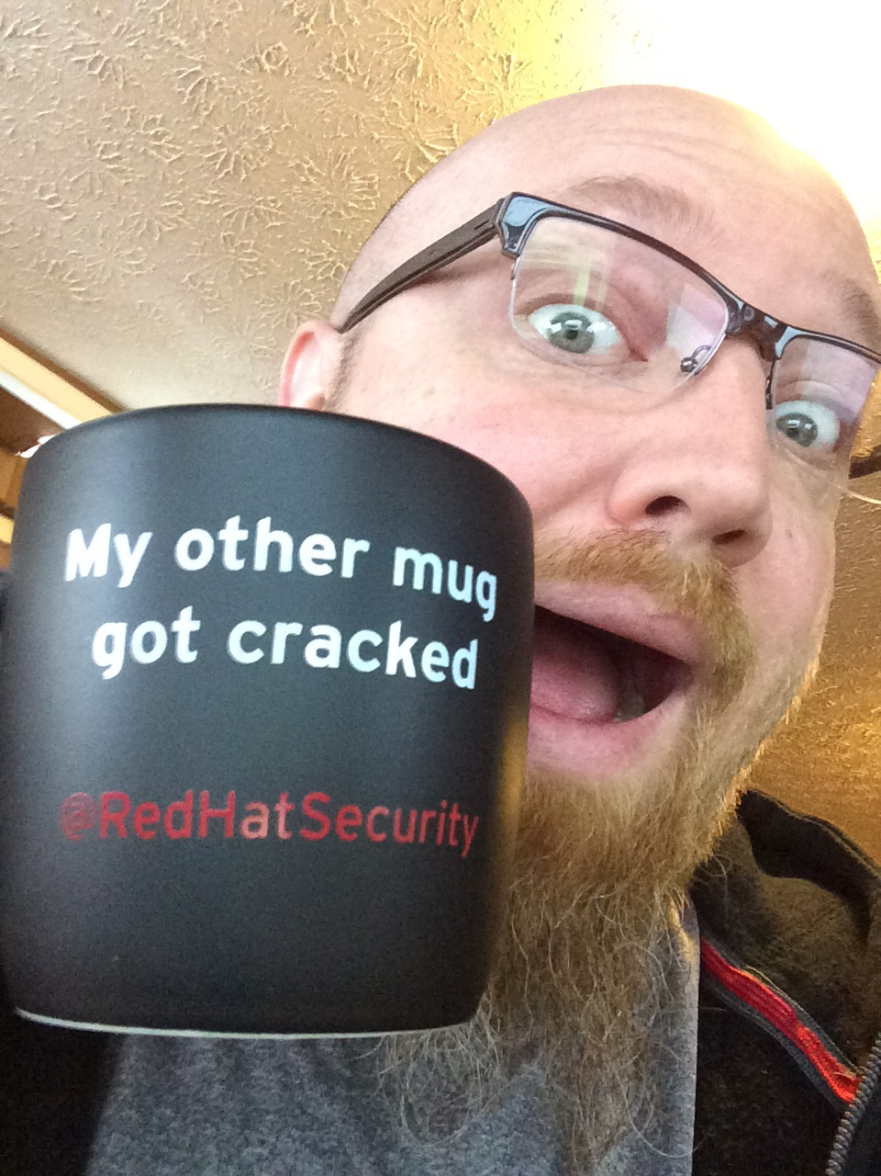
Who is this clown?!
CRob, n, adj, and v
Pronunciation: U.S. (K-robe)
Over 20 years of Enterprise-class Architecture, Engineering, Operations, and Security experience
Ambassador of Red Hat Product Security
Participant in the FIRST PSIRT SIG, VulnCoord SIG, and others
Co-Author FIRST PSIRT Services Framework
Pirate-enthusiast & hat-owner

Slide 4
—SOMEONE FAMOUS
“This is a quote. Words full of wisdom that someone important said and can make the reader get inspired.”

Slide 5
Table of contents
01
introduction
02
Presentation
03
Conclusion
Why OSS is important
The stuff about the title that draw you to sit here and listen
Reflections on the amazing revelations you have witnessed
during the hour

Slide 6
01
This is a great headline:
OSS Won!
(yay!)

Slide 7

OSS is kind of
A BIG DEAL
“FOSS constitutes 80-90% of any
given piece of modern software, and
software is an increasingly vital resource in
nearly all industries. This heavy reliance
on FOSS is common in both the public and private sectors, and among tech and non-tech
companies alike. Therefore, ensuring the health and
security of FOSS is critical to the future of nearly all
industries in the modern economy.” - Linux Foundation’s “Vulnerabilities in the Core” report - Feb2020
https://www.coreinfrastructure.org/wp-content/uploads/sites/6/2020/02/census_ii_vulnerabilities_in_the_core.pdf

Slide 8
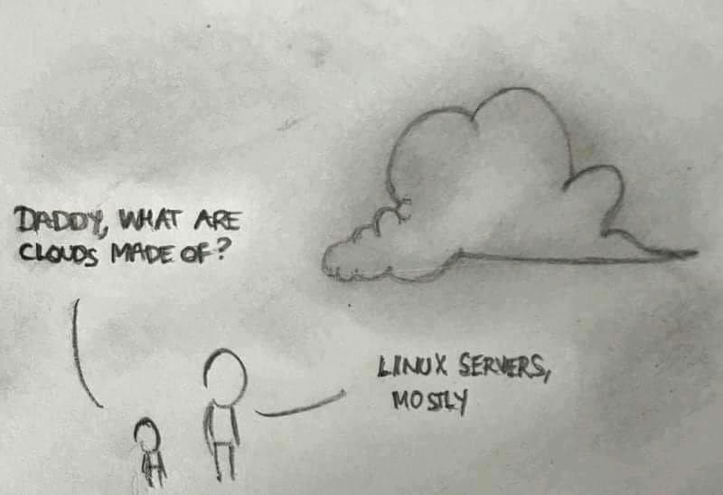

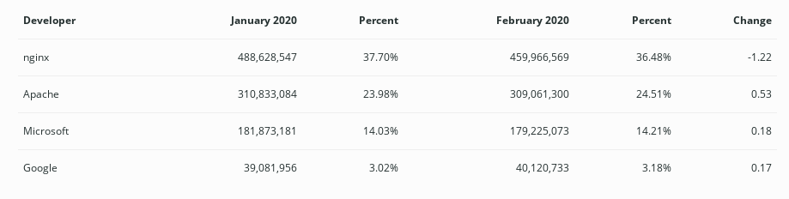
02
A picture always reinforces the concept
# of Active Webservers on the Intertubes - https://news.netcraft.com/archives/category/web-server-survey/
Notes:
image - https://i.redd.it/l4bu591x5syy.jpg

Slide 9
Some quick OSS Stats
# of people contributing
OSS cve #s?
WHO is USING OSS?
40+Mil Gitlab users
over 10Mil new in 2019 alone
https://octoverse.github.com/
Searching for “the Linux” in NVD tells me there were
17,311
OSS CVEs in 2019
2.9+Mil organizations use public or private git repos
Notes:
source - https://octoverse.github.com/

Slide 10
02a
This is a great headline:
OSS YEAR-IN-REVIEW & TRENDY TRENDS!

Slide 11


OUr Perspective!
Red Hat Inc - a small enterprise software company using an open source development model
25+ years in the industry
Community leadership in
Linux Kernel
Kubernetes
Apache Foundation
OpenSSL
RDO
...and SO many more
!
Every year we compile a Risk Report, which is the source of a lot of the following data point, augmented with community facts

Slide 12
WHERE you get your open source MATTERS
Free fish aren’t free
supply chain
We’ve talked about this before, just because the code is free doesn’t mean you want it.
https://www.first.org/resources/papers/hillsboro2019/Free-Fish-Aren-t-Free.pdf
Your customers are transferring THEIR software risks to YOU, their supplier, and are expecting YOU to conduct reasonable due diligence/management of the bits you give THEM
https://www.linuxfoundation.org/wp-content/uploads/2020/02/oss_supply_chain_security.pdf

Slide 13
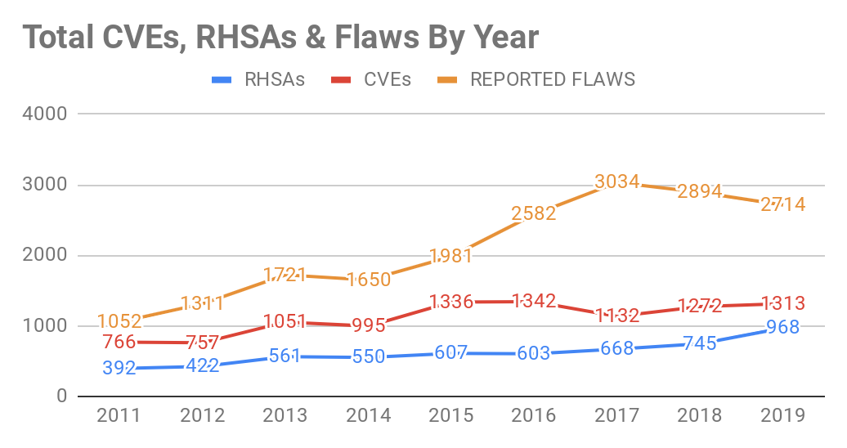
Reinforce the concept using graphs and charts!
Flaws reported
Some years are busier than others, but overall our Incoming must sift through A LOT of reports
CVEs Fixed
Certainly not out busiest year (/me shakes fist at 2016) we fixed more vulnerabilities than the last several years
Trend Observations
More vulns are found every year, our customers want more patches more quickly to “make the scanner pain go way” <--more on THIS in a bit!
Advisories Issued
This is a result of more products and more longer-life support streams. This is new work for product engineering and our customers to address

Slide 14
Think About the Attack Surface You are supporting
Product | # of Packages
Red Hat Enterprise Linux 8.1 - default w/GUI | 1348 RPMs
Red Hat Enterprise Linux 8.1 minimal | 405 RPMs
Red Hat Enterprise Linux 8.1 - full | 2321 RPMs [525 (Base OS) + 1796 (AppStream)]
Red Hat Enterprise Linux 7.7 - default | 343 RPMs
Red Hat Enterprise Linux 7.7 - full | 2319 RPMs
Red Hat OpenStack Platform 15 | 736 RPMs + underlying OS
Red Hat OpenShift Container Platform 4.2 | 200 components + underlying OS
Red Hat JBoss Enterprise Application Platform 7.2.4 | 530 jars + underlying OS
“Fun” Fact - Red Hat Product Security monitors over 450,000 OSS packages/versions that are included in our portfolio

Slide 15
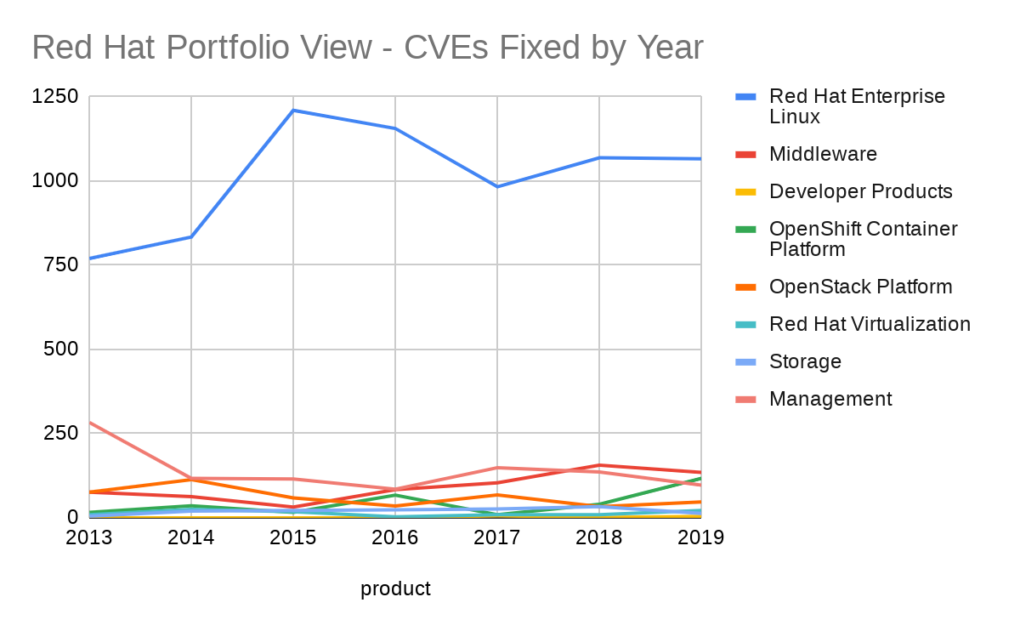
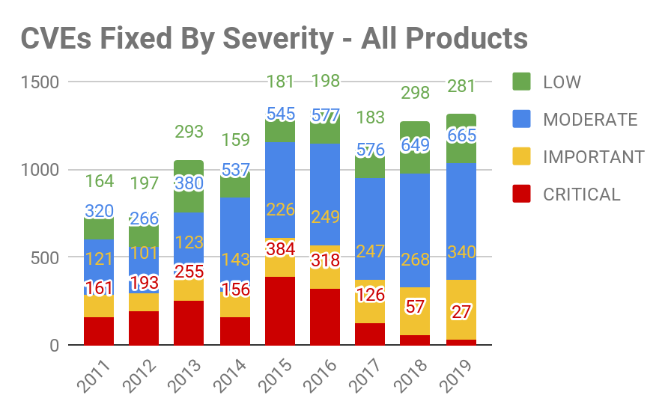
I see
VULNERABILITIES
Overall, we’re seeing fewer CRITICAL issues, but are slowly being flooded by MODERATES

Slide 16
Component | # of CVE's (this includes multiple affected version numbers of a product) | CWE counts (included if 15+ for top 5)
kernel | 216 | cwe-200(19), cwe-203->cwe-385(47), cwe-400(22), cwe-284(20), cwe-416(16)
thunderbird | 156 | cwe-120(24), cwe-416(27), cwe-829(24), cwe-843(15)
firefox | 152 | cwe-120(25), cwe-416(27), cwe-829(24), cwe-843(16)
chromium-browser | 131 | cwe-416(2), cwe-20(1), cwe-125(1)
jackson-databind | 123 | cwe-502(93), cwe-502->cwe-200(18)
kernel-rt | 112 | cwe-200(13), cwe-385->cwe-203(13), cwe-416(13)
mysql:8.0/mysql | 95 | n/a
rh-mysql80-mysql | 95 | n/a
java-1.8.0-ibm | 69 | cwe-20(8)
qemu-kvm-rhev | 59 | cwe-122(13), cwe-203->cwe-385(24)
qemu-kvm | 44 | cwe-203->cwe-385(32)
libvirt | 39 | cwe-203->cwe-385(32)
Uncontrolled Resource Consumption
Covert Timing Channel
Since 2019 did not pan out to be the year of the Linux desktop, let’s put these 3 packages to the side.
Maybe 2020 will be our year?
Deserialization of Untrusted Data
Nar-nope
Covert Timing Channel

Slide 17
02b
This is a great headline:
Trendy Trends that are trendily trending!

Slide 18
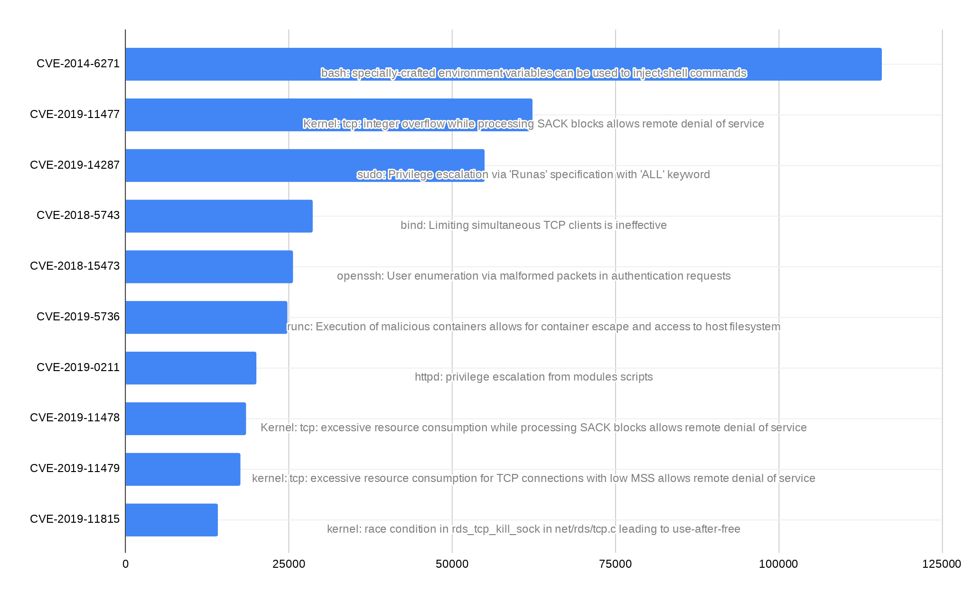
Interesting Issues of 2019
 | CVE | Name | Severity
1 | CVE-2019-5763 | runc malicious container escape | IMPORTANT
2 | CVE-2018-12130, CVE-2018-12126, CVE-2018-12127 & CVE-2019-11091 | MDS - Microarchitectural Data Sampling | IMPORTANT / MODERATE
3 | CVE-2019-11477, CVE-2019-11478, & CVE-2109-11479 | TCP SACK Panic | IMPORTANT / MODERATE
4 | CVE-2019-10161, CVE-2019-10166, CVE-2019-10167, & CVE-2019-10168 | libvirt privilege escalation | IMPORTANT
5 | CVE-2019-1125 | Spectre SWAPGS gadget vulnerability | MODERATE
6 | CVE-2019-14835 | VHOST-NET Guest-to-Host Escape | IMPORTANT
7 | CVE-2019-14287 | sudo: Privilege escalation via 'Runas' | IMPORTANT
8 | CVE-2018-12207 | Machine Check Error on Page Size Change | IMPORTANT
9 | CVE-2019-11135 | Transactional Synchronization Extensions (TSX) Asynchronous Abort | MODERATE
10 | CVE-2019-0155 & CVE-2019-0154 | i915 Graphic Driver | IMPORTANT / MODERATE
#3
#7
#1
#3
#3

Slide 19
#@$%!
SCANNER.VENDORS--
package version# != RISK
https://www.redhat.com/en/blog/why-cvss-does-not-equal-risk-how-think-about-risk-your-environment

Slide 20


The DEATH OF The BRAnded FLAW ?
While I’m not putting out the “Mission Accomplished” banner just yet….
2019 saw a BIG drop in nonsense around branding of flaws, with only a few passing our desks that tried to set the hype to 11.
Our customers were not impressed by the marketing this time around. Ideally this trend continues into 2020 and BEYOND!
Notes:
image - https://i.kym-cdn.com/photos/images/newsfeed/000/930/949/fb4.gif

Slide 21
NOT ONE CPU FLAW OR BRANDED ISSUE WAS BEHIND ANY REPORTED 2019 BREACHES
MOST SECURITY INCIDENTS OUR CUSTOMERS EXPERIENCE ARE A COMBINATION OF INTENTIONAL OR UNINTENDED HUMAN ERROR, POOR SECURITY HYGIENE, OR LACK OF SECURITY AWARENESS
Our pals at Verizon state the C-level execs are TWELVE times more likely to be a target of social attacks.
C-level folks don’t have access to anything important, right?
Malware delivered via e-mail is STILL the most popular attack vector. Ransomware was involved in ~ 24% of those campaigns.
Cloud is great for yours and your customers’ businesses? Cool story, bro...it’s great for the attackers too!
Attackers are using DevOps practices to scale up/scale down their attacks to be more cost-effective as well as probing this “new datacenter” for open vulnerabilities
AS A DISCIPLINE/INDUSTRY, INFORMATION SECURITY IS FOCUSING ON THE WRONG THREATS!
https://enterprise.verizon.com/resources/reports/dbir/

Slide 22

Now, a more sobering topic
Notes:
image - http://www.quickmeme.com/img/5f/5fe03ddff8bc25ec63b2ae5db308290ee87ceeea1c6f1c1c4d0a035b1af7e66e.jpg

Slide 23

RIPPED FROM THE HEaDLINES!
“According to the Github discussion …. the longtime event-stream developer no longer had time to provide updates. So several months ago, he accepted the help of an unknown developer. The new developer took care to keep the backdoor from being discovered. Besides being gradually implemented in stages, it also narrowly targeted only the Copay wallet app. The malicious code was also hard to spot because the flatmap-stream module was encrypted.” - Ars Technica 11/26/2018
April 2018
webmin - web-based admin tool - unknown attacker changes password_change.cgi - downloaded over 491,000 times
Dec 2018
cloudhopper - supply chain attack targeting HPE & IBM to exploit THEIR customers
Nov 2018
event-stream - popular oss library (over 2mil users)- malicious code inserted targeting Copay bitcoin wallets
Notes:
https://arstechnica.com/information-technology/2019/08/the-year-long-rash-of-supply-chain-attacks-against-open-source-is-getting-worse/
https://arstechnica.com/information-technology/2018/11/hacker-backdoors-widely-used-open-source-software-to-steal-bitcoin/
https://blog.sonatype.com/cyber-risk-in-2019-its-about-the-supply-chain-stupid
https://www.reuters.com/article/us-china-cyber-hpe-ibm-exclusive/exclusive-china-hacked-hpe-ibm-and-then-attacked-clients-sources-idUSKCN1OJ2OY

Slide 24
KEEPING AN EYE ON THE SUPPLY
In a 2019 report, Symantec observed supply chain attacks rose 78% in 2018.
I’m “eagerly” waiting for this year’s iteration of that research.
TO DATE these attacks seem to be very targeted, most seeking to embed cryptocurrency miners or to redistribute malware to execute 2nd-stage attacks/move laterally post-compromise.
My PERSONAL favourite being DORKBOT, an IRC-based worm that seeks to scrape sensitive info and conduct DDoS attacks IRC.4EVA,YO!
https://www.mhlnews.com/global-supply-chain/article/22055712/supply-chain-facing-increased-cyber-attacks
https://www.microsoft.com/security/blog/2019/10/16/guarding-against-supply-chain-attacks-part-1-big-picture/

Slide 25
03
This is a great headline:
Conclusions, Advice, and shoulders to cry upon

Slide 26

WHERE
You get your software Matters
Only download software from KNOWN good sources
Dedicate resources (people, tools, infra) to the projects that matter to you
Conduct your own scans/assessments to ensure code meets your quality standards
Partner with an OSS vendor you can hold accountable
What can you do to protect yourself and your customers?

Slide 27

...Enhance your calm
keep breathing, it’ll all be OK

Slide 28

Sometimes, reviewing concepts is a good idea
KNOW THYSELF
If you do not understand what makes up your products, how can you protect them?
OSS COMMUNITIES ARE THRIVING
Dozens of new projects come online daily
Supply chain
YOU get to hold your customers’ oss-cyber risk (yay you!). Inspect where your code comes from and how it changes
YOU ARE NOT ALONE
Not only are OSS-communities welcoming, so are orgs like FIRST!

Slide 29

Thanks!
Does anyone have any questions?
crob_at_redhat_dot_com
@RedHatCRob
the interwebs
Notes:
image - https://9gag.com/gag/aQ1Ebnq/this-is-the-way-i-have-spoken

Slide 30
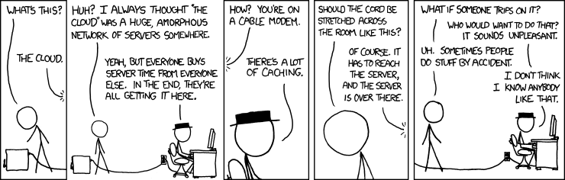
Notes:
image - https://xkcd.com/908/

Slide 31
Credits
This is where you give credit to the ones who are part of this project.
Did you like the resources on this template? Get them for free at our other websites.
Presentation template by Slidesgo
Icons by Flaticon
Images & infographics by Freepik
Author introduction slide photo created by Freepik
Text & Image slide photo created by Freepik.com
Big image slide photo created by Freepik.com

